Slide 1
Final Project Report:
Sales Forecasting with FNN
Kayah Whipps & Diane Marikit Tio

Slide 2
Who and Why?
Intertwining business and machine learning
Identifying patterns and predicting trends in sales
Audience: Businesses interested in sales forecasting and improved strategic planning
Notes:
Marikit
Business analytics

Slide 3
Research Questions
What is the business goal?
Accurately forecasting the yearly sales for 2025 by department.
Can an FNN model outperform traditional sales forecasting model?
What factors impact sales the most?
Notes:
Kayah

Slide 4
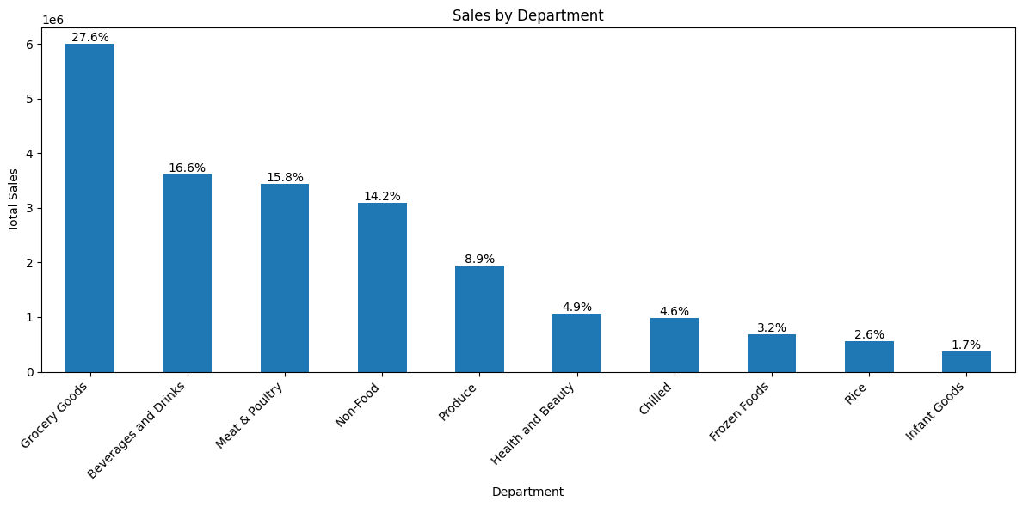
Exploring Our Sales Dataset
Sales data from Surangel and Sons Co. covering 2024
Total Records: 20295
Number of Features Used: 27
Important Features:
Sales Trends
Quarterly sales
Monthly averages
Product & Department Data
Categories
Pricing
Past performance
Notes:
Kayah

Slide 5
Cleaning and Preparing Data for Machine Learning
Handling Missing Data:
Filled missing values with zero
Checked for outliers and incorrect values
Feature Engineering
Created new features for quarterly trends and volatility
One-hot encoded categorical variables (dept_code_GB, etc.)
Feature Scaling
Used StandardScaler to normalize numerical values
Train-Test Split and Validation Split Breakdowns
Training Data: 64%
Validation Data: 16%
Test Data: 20%
Notes:
Kayah

Slide 6
Benchmark Model: Linear Regression
Why Use a Benchmark Model?
We need a simple, interpretable model as a baseline
Why Linear Regression?
Fast & interpretable
Good at capturing basic trends
Useful for comparison
Key Takeaways:
Too simple for complex data
Overfits training data
FNN can handle non-linearity, seasonality, and complex interactions better
Metric | Value
Training RMSE | 527.80
Test RMSE | 2013.38
Training R^2 | 0.993
Test R^2 | 0.930
Notes:
Kayah

Slide 7
Our FNN Model
Final Model:
Hidden layers: 3 fully connected layers (96, 48, 24 neurons).
Activation Function: LeakyReLU (non-linearity for better learning).
Regularization: L2 (0.0002) to prevent overfitting.
Dropout: 0.3, 0.1 for better generalization.
Batch Size: 64 for stable training.
BatchNormalization: helps with generalization
Learning Rate: 0.001, allowed for convergence.
Model Training:
64% Training, 20% Testing, 16% Validation
Early Stopping to prevent overfitting
Notes:
Marikit
Took many hours and a lot of trial and error
Experimented with learning rate decay, different optimizers, and different neuron sizes.

Slide 8
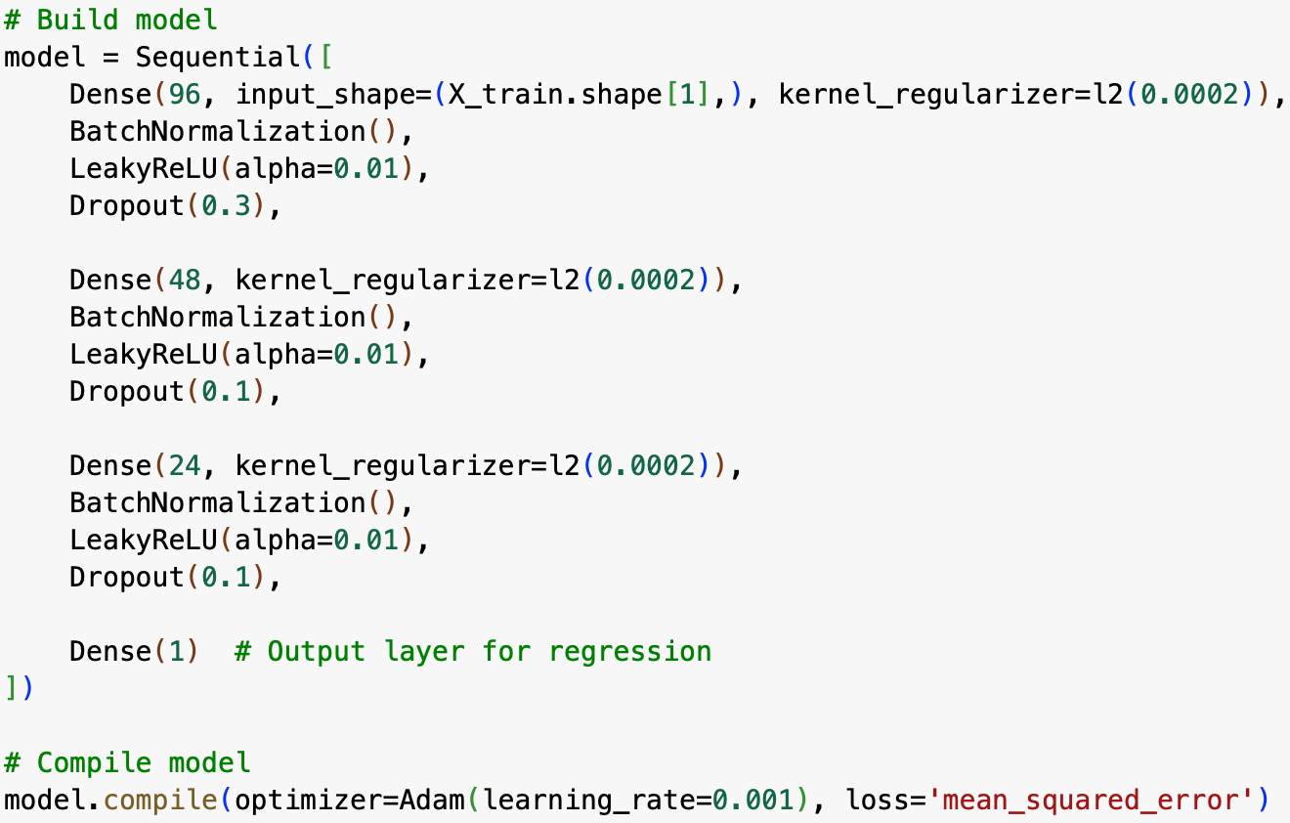
Our FNN Model

Slide 9
How Well Does Our Model Predict Sales?
Metric | Value | Ideal Range | Interpretation
Training RMSE | 1175.84 | ~1000 - 1500 | Good, fits training data well
Val RMSE | 648.31 | ~1100 - 1500 | Too low, memorizing data
Test RMSE | 2653.76 | ~1800 - 2300 | Too high, poor generalization
Training R^2 | 0.967 | 0.90-0.96 | High, might be too perfect
Val R^2 | 0.988 | ~0.87-0.92 | Too high, overfitting
Test R^2 | 0.879 | 0.85-0.92 | Decent
Key Takeaways:
Model performs well on training data, but Test RMSE still too high
Some overfitting still present
Next goal: improve generalization
Notes:
Marikit
Benchmark test: 0.930
Ideal range we got through research (see below)
Results differ between runs, but this is from our best run
Our goal was to get the test r^2 higher so that the predictions can be more accurate
“Ideal” MSE depends on the dataset, but generally:
• Test RMSE should be lower than the naive baseline RMSE.
• Test RMSE should be in proportion to the standard deviation of sales.
• RMSE should be ~10-30% of average sales for a strong model.
• Test RMSE should be close to Training RMSE to ensure generalization.
• Deep learning should outperform simple models like Linear Regression.

Slide 10
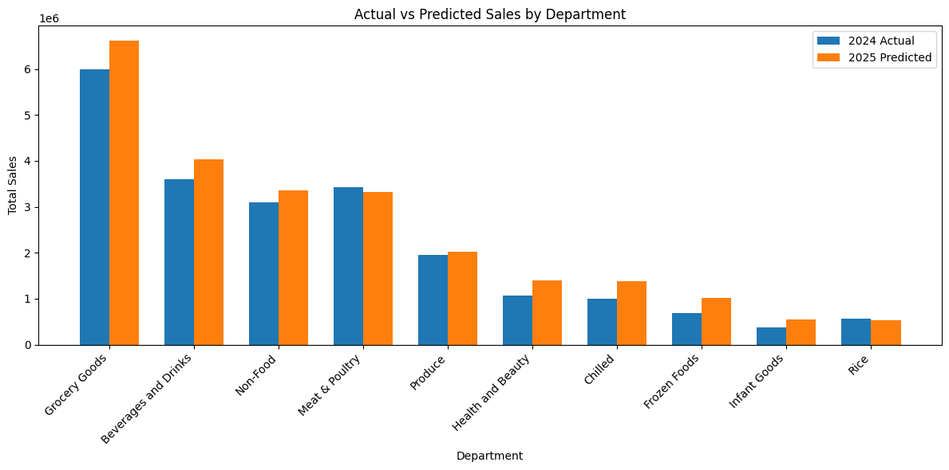
Notes:
Marikit
Our best predictions, showing that our model is able to predict sales well

Slide 11
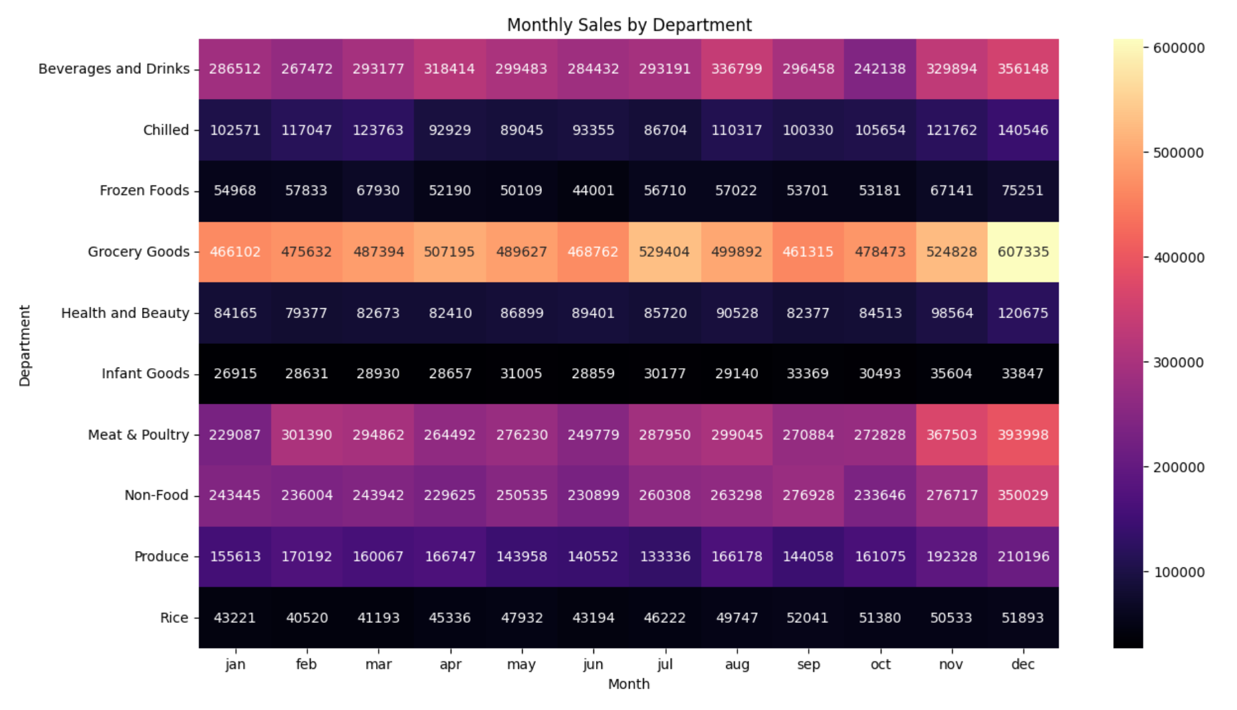
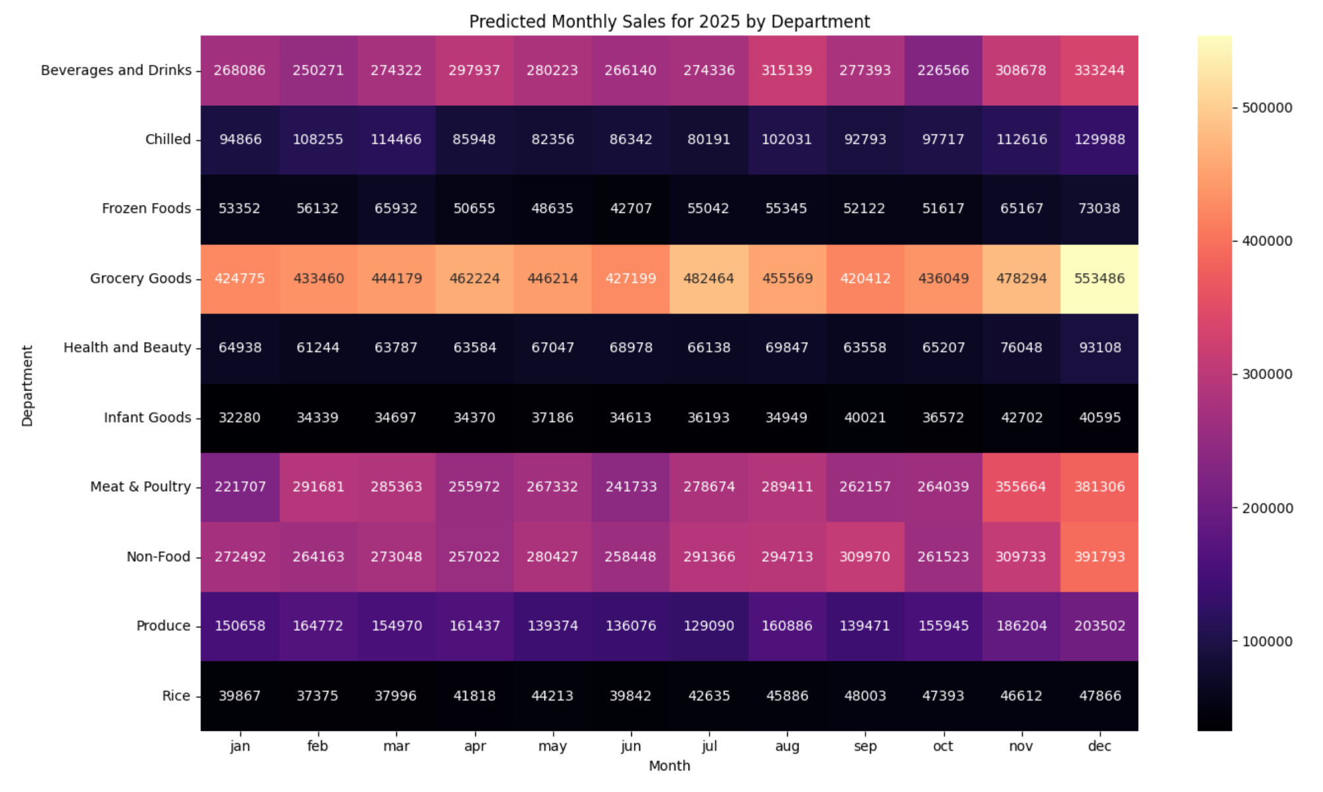
Actual vs. Predicted Heatmap Comparison
Notes:
Marikit
Heatmaps from a different run
The heatmaps are in the same range, proving that our model has the right idea. However it does display an excess of negative growth, meaning that our model needs to be improved

Slide 12
Conclusion and Recommendations
Key Findings:
FNN outperformed Linear Regression in forecasting accuracy
Overfitting was the biggest challenge
The model still needs improvement
Recommendations for Future Work:
Hyperparameter tuning
Try different model architectures
Feature engineering
add external factors like promotions or economic indicators
Deploy the model for real-time sales forecasting
Notes:
Kayah
complex models:
Long Short-Term Memory Networks - if sales forecasting depends on long-term patterns
Transformer-Based Models - if sales forecasting depends on many interacting features

Slide 13

Thanks!
Do you have any questions?
Please keep this slide for attribution

